Slide 1

Drug Recommendation system

Slide 2
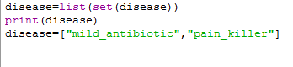
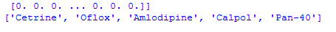
Based on diseases

Slide 3
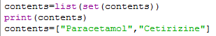
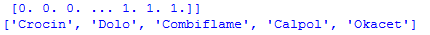
Based on contents of a drug

Slide 4

Drawbacks and Future scope

